Slide 1
Multi-Multi-Multi
Tanaka and Mika

Slide 2
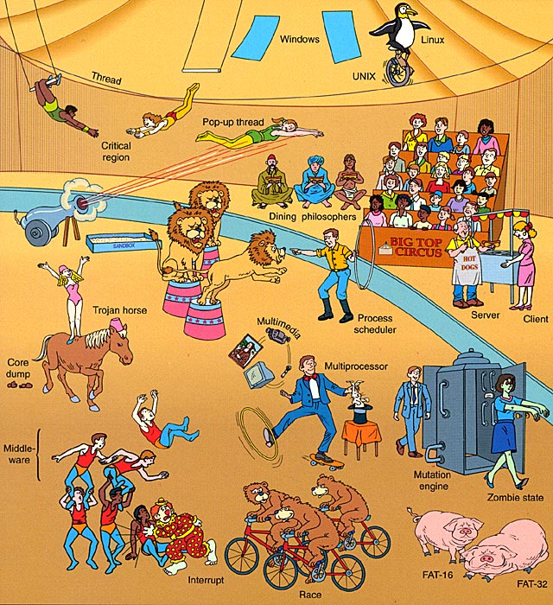
Modern Operating Systems, cover art

Slide 3
Multiprogramming
Formal definition:
More than one program running concurrently in a single computer [1]
Informal explanation:
A multiprogramming system interrupts a running program when it goes for an I/O task and starts executing a second program from the waiting queue. This repeats as many times as necessary to always keep the CPU busy as long as there are processes to execute. As soon as a job completes the I/O operation, CPU is reallocated. [2]

Slide 4
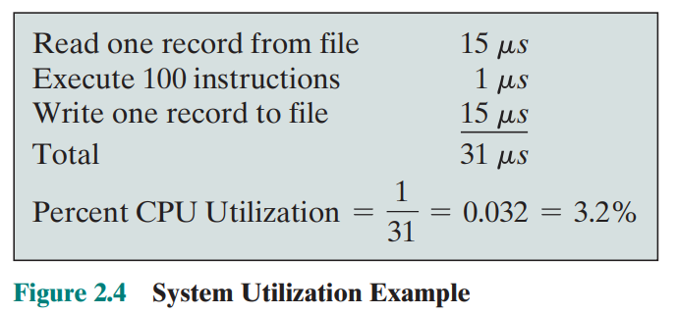
Why is it important?
I/O devices are extremely slow compared to the processor. As illustrated on page 77 of the textbook, 96% of the processor time in this uniprogramming example was spent waiting for I/O devices to finish transferring data to and from the file.
This inefficiency could have been avoided by running the next program while waiting for the I/O devices to complete.

Slide 5
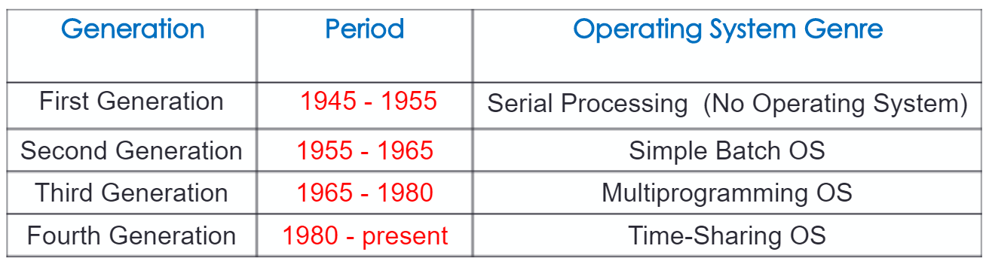
Timeline

Slide 6
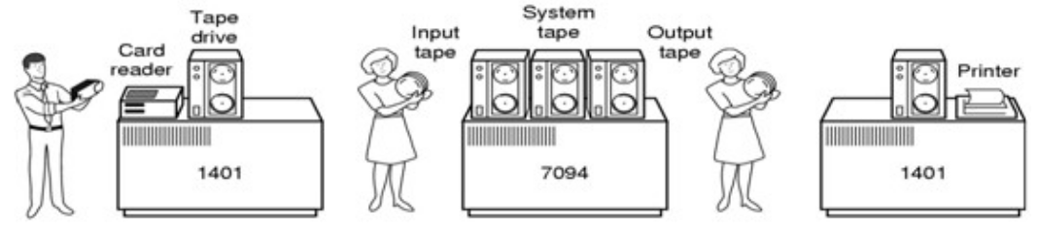
Timeline cont.: Simple Batch OS (mid 1950s - mid 1960s)
- Batch systems introduced to reduce waste time in setting up and running jobs (compared to serial processing)
-To speed up processing, jobs with similar needs are batched together and run as a group
-Jobs read in via punched cards. Used uni-programming, computer executes one job at a time until finished
-Biggest problems are the lack of interaction between user and job and the CPU is often idle

Slide 7
Timeline comt.: Multiprogramming (mid 1960s to 1980)
-LEO III (1961): solid-state machine with a 13.2 μs cycle time. All LEO IIIs allowed concurrent running of as many as 12 application programs through the "Master program" operating system. Some, primarily producing telephone bills, were still in commercial use with GPO Telephones until 1981.
-THE multiprogramming system (1965): computer OS designed by a team led by Dijkstra. Significant for its use of layers, with layer 0 responsible for multiprogramming. Introduced the first forms of software based virtual memory and semaphores used a programming construct for the first time. [5]
The use of multiprogramming was enhanced by the arrival of virtual memory and virtual machine technology, which enabled individual programs to make use of memory and operating system resources as if other concurrently running programs were, for all practical purposes, non-existent and invisible to them.

Slide 8
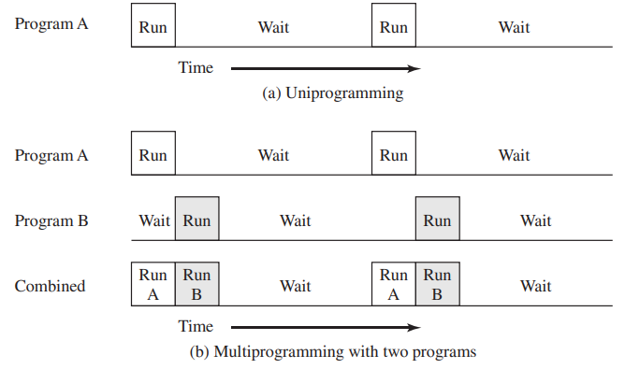
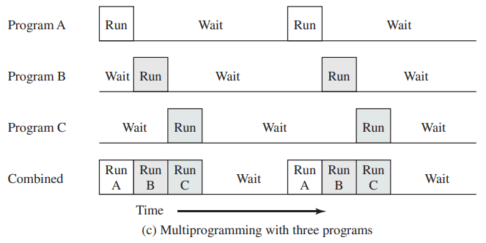
Historical Significance- Increase in Throughput
Simple Batch OS

Slide 9
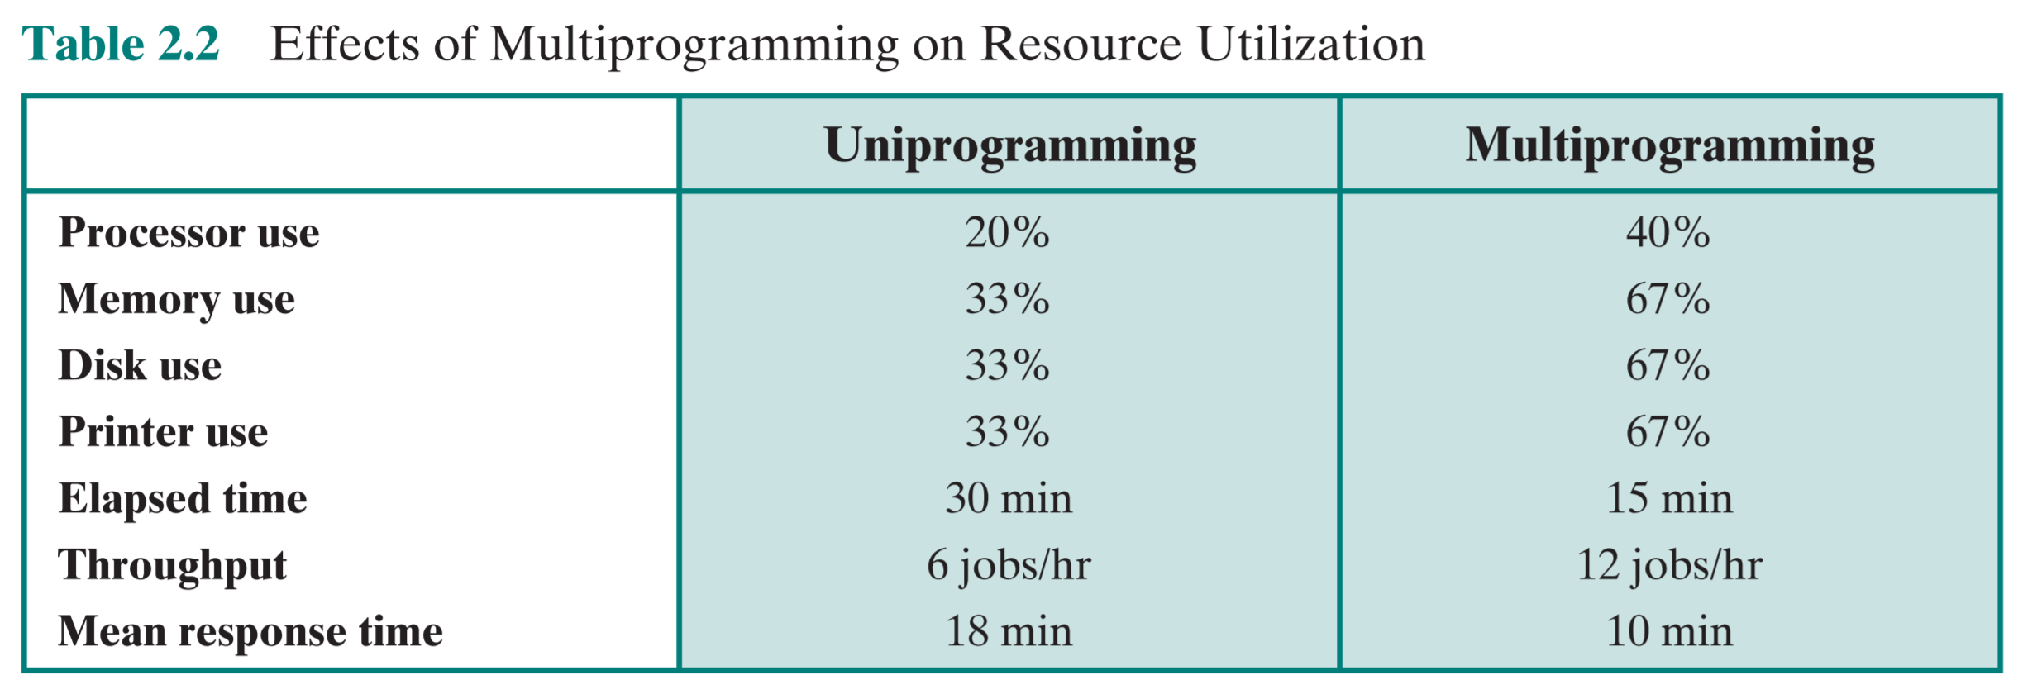
Historical Significance- Increase in Throughput

Slide 10
Historical Significance
Multiprogramming became possible when disks were introduced to the computing world. The concept of multiprogramming relies on the capability of a computer to store instructions (programs) for long-term use.
This introduced a new responsibility for operating systems- decision making. Before multiprogramming, the role of the operating system was simple- load a program into memory and execute it via the CPU.
Multiprogramming OSs introduced the address space abstraction for primary memory.
Notes:
With the advent of multiprogramming, operating systems now faced different mechanics for program execution as multiple jobs now needed to be loaded into memory at the same time and several options existed for allocating CPU time. [3]

Slide 11
Multiprocessing
Formal definition:
A computer that has two or more processors with common access to a main storage
Informal explanation:
In a uniprocessor system, only one process executes at a time. Multiprocessing is the use of two or more CPUs (processors) within a single computer system.

Slide 12
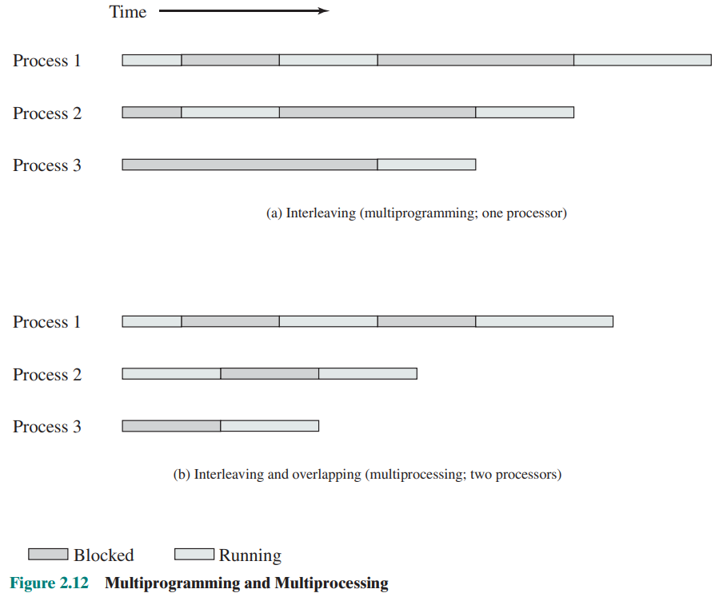
Multiprogramming v. Multiprocessing
With multiprogramming, only one process can execute at a time; meanwhile all other processes are waiting for the processor.
With multiprocessing, more than one can be running simultaneously, each on a different processor.

Slide 13
Multiprogramming v. Multiprocessing
Multiprogramming ===> software (i.e., running processes)
Multiprocessing ===> hardware (i.e., the CPU units)
If the underlying hardware provides more than one processor then that is multiprocessing.

Slide 14
Multiprogramming v. Multiprocessing
A system can be both multiprogrammed (by having multiple programs running at the same time) and multiprocessing (by having more than one physical processor).
Multiprocessing occurs by parallel processing whereas multiprogramming occurs by context switching.

Slide 15
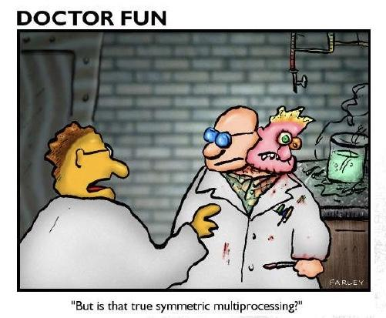
Symmetric Multiprocessing
Symmetric multiprocessor:
Two or more similar processors of comparable capability
Share the same main memory and I/O devices (connected by a bus or other connection scheme) with UMA
All processors can perform the same functions, hence symmetric
Controlled by an integrated operating system that provides interaction
*Most multiprocessor systems today use an SMP architecture*

Slide 16
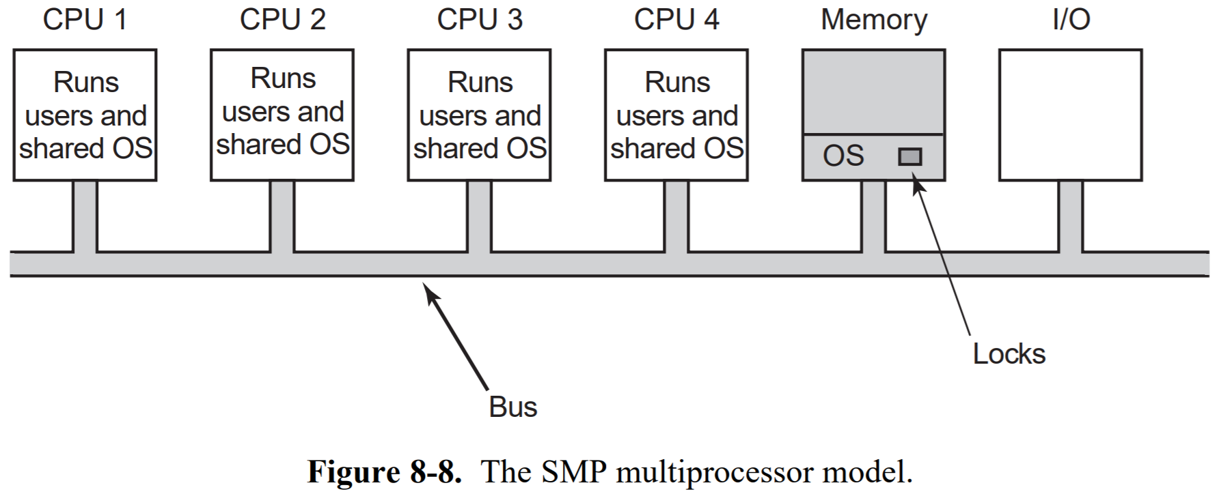
Symmetric Multiprocessing

Slide 17
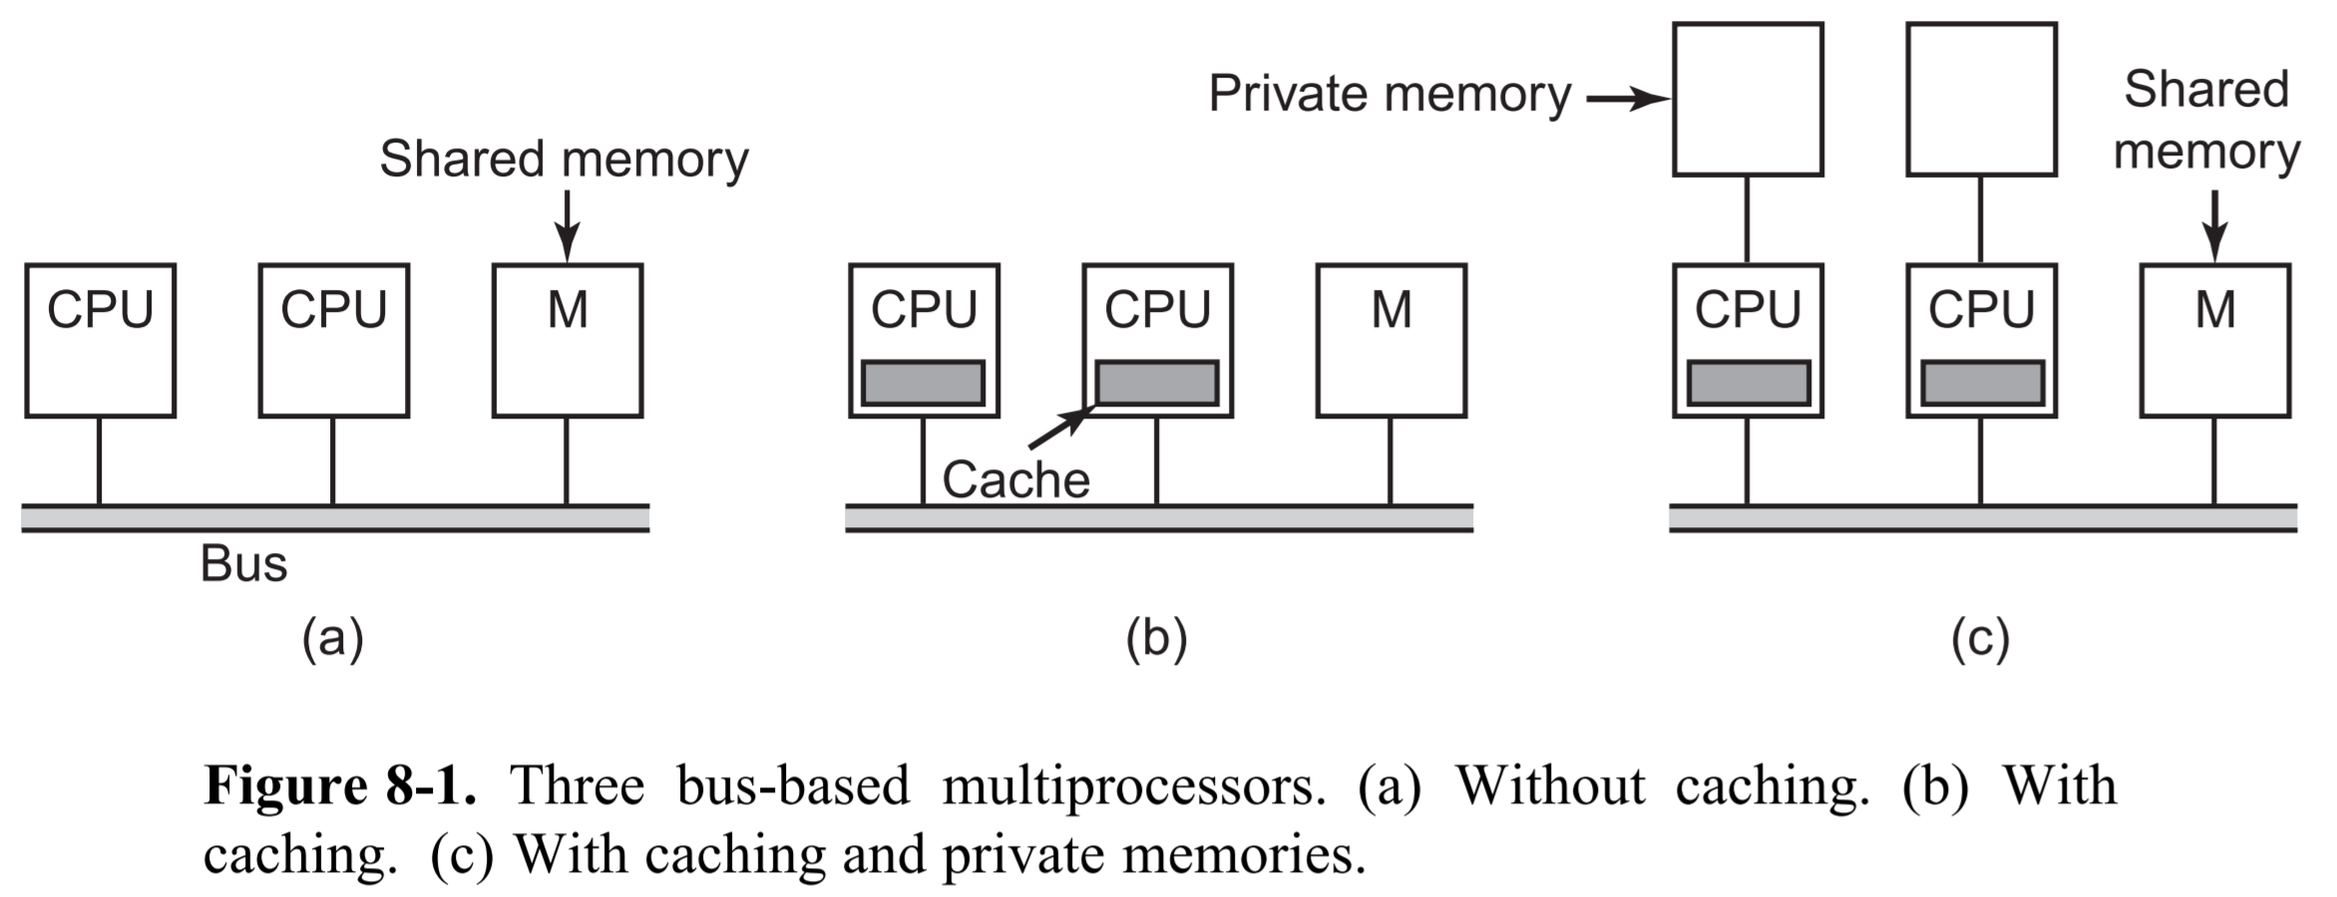
Multiprocessing with a Shared Single Bus

Slide 18
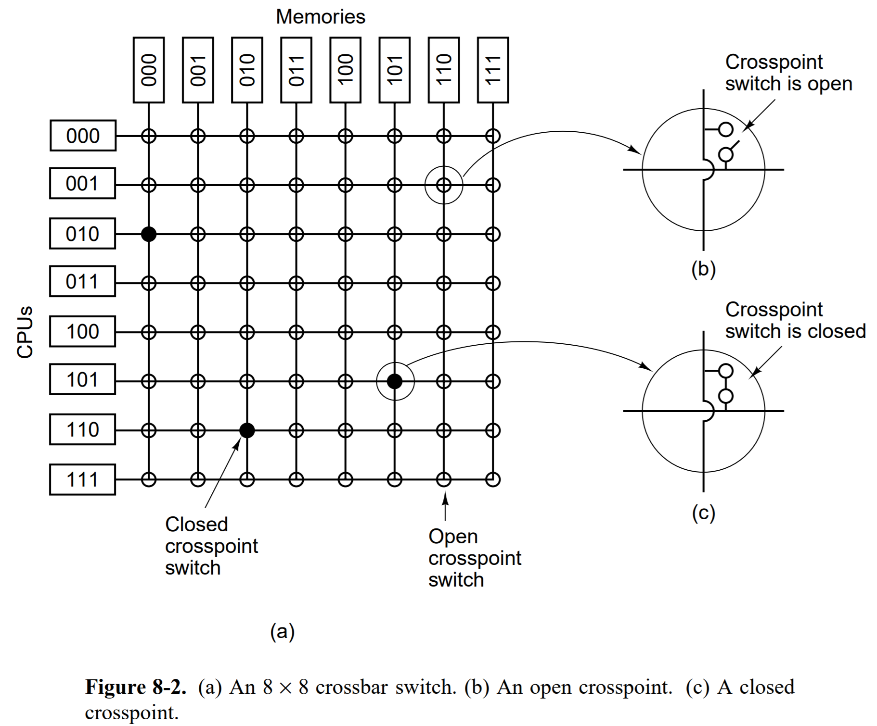
Multiprocessing using Crossbar Switches
- The simplest circuit for connecting n CPUs to k memories is the crossbar switch.
-At each intersection of a horizontal and vertical line is a crosspoint.
Pros: non-blocking network
fast: direct connections allow for O(1) latency
Cons: number of crosspoints grows as n²
very expensive to make
A crossbar design is workable for medium-sized systems.

Slide 19
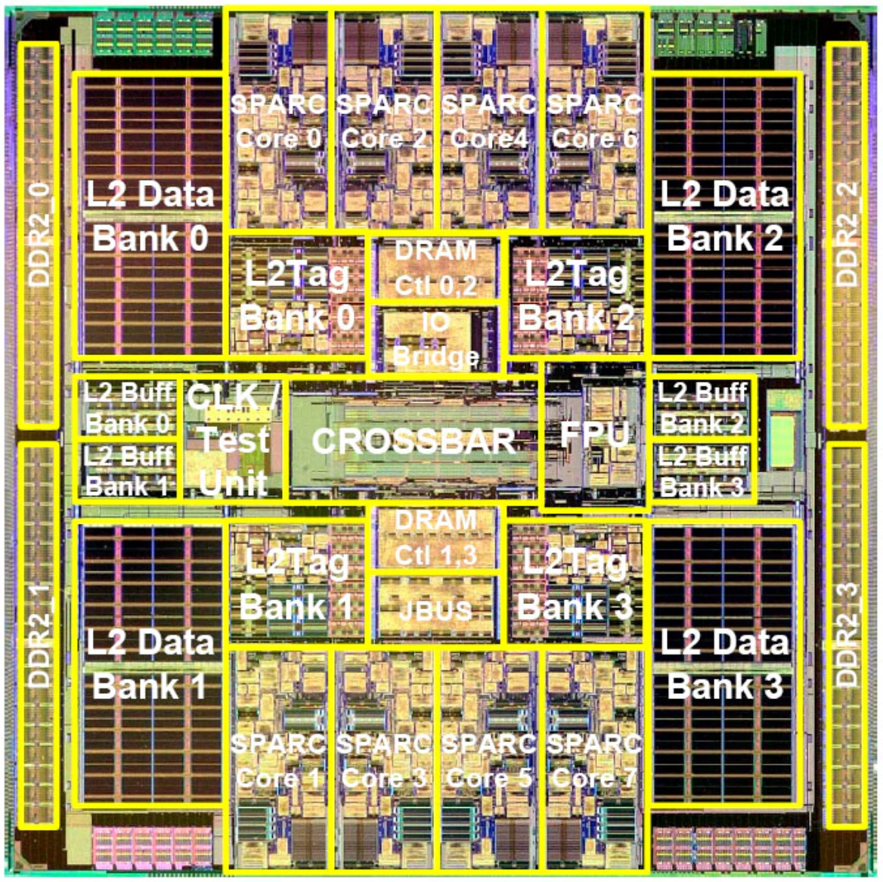
Real World Example:
Developed in 2007 by Sun Microsystems, the Sun UltraSPARC T2 is a microprocessor that uses a full crossbar for its 4, 6 or 8 cores (there are 8 in the figure shown).
Complexity of the chip's crossbar interconnect makes it almost the size of a CPU core! Large and inefficient.

Slide 20
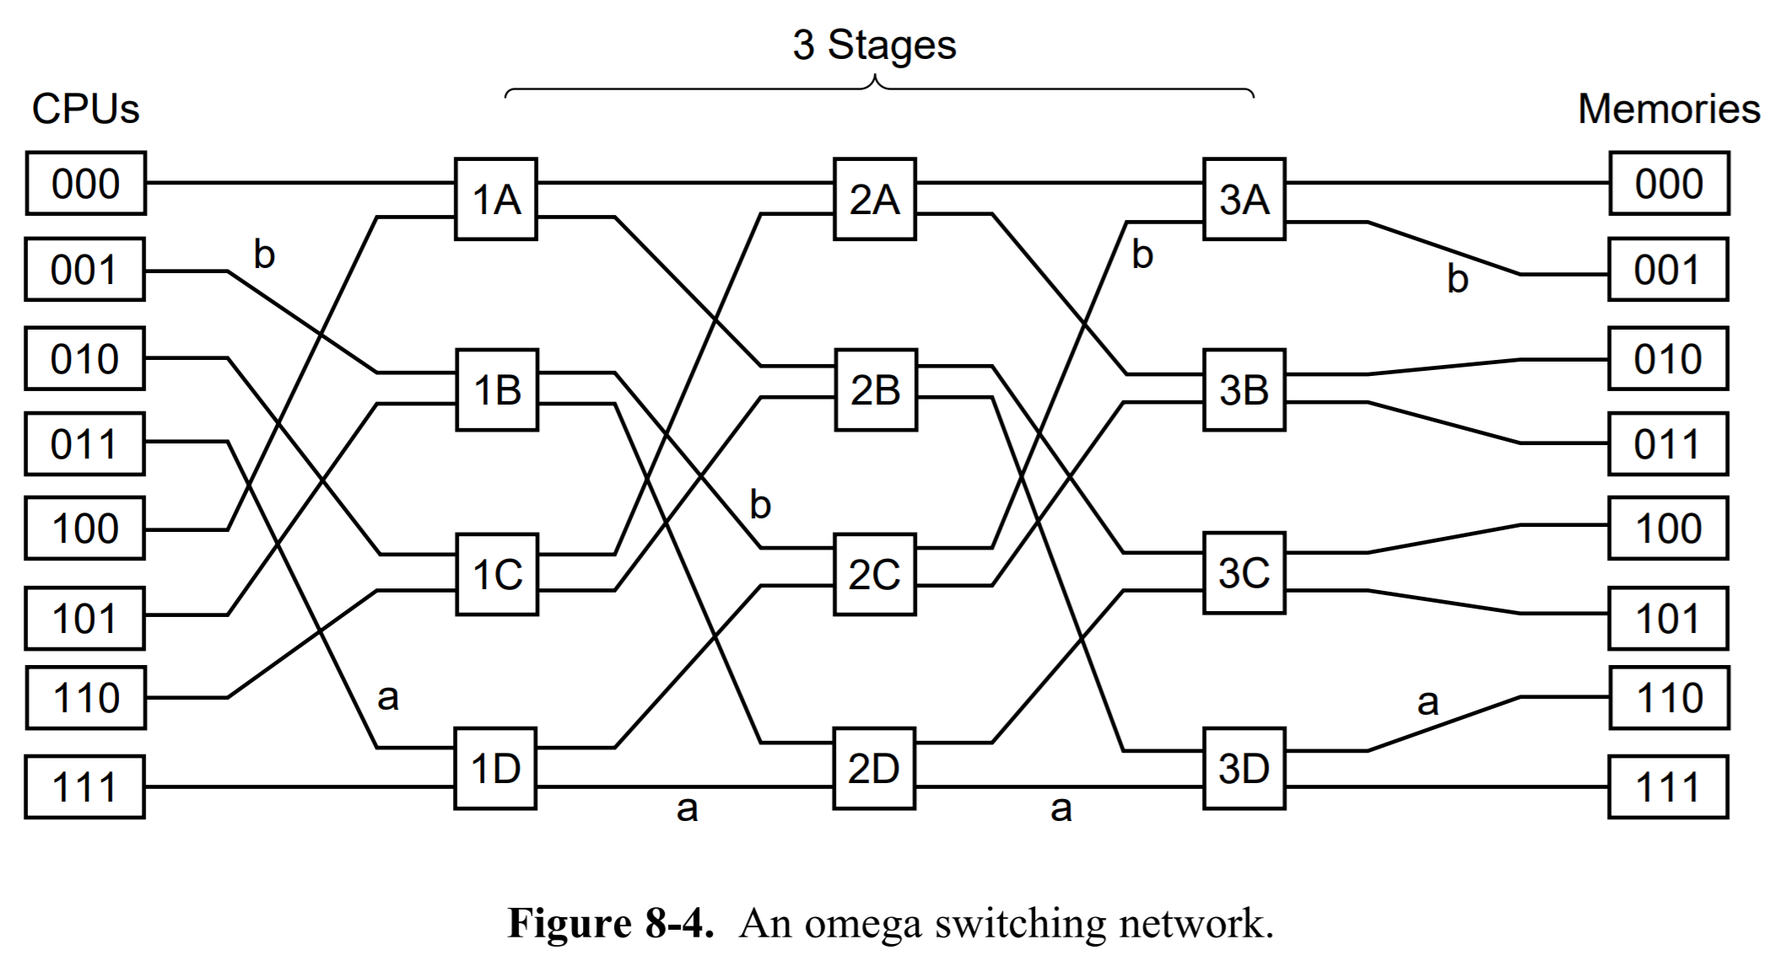
Multiprocessing using Multistage Switching Networks
-Based on 2x2 switches
-For n CPUs and n memories we would need log₂n stages, with n/2 switches per stage, for a total of (n/2)log₂n switches
-Unlike the crossbar switch, the omega network is a blocking network
-Interleaved memories maximize parallelism because most memory references are to consecutive addresses
Notes:
A memory system in which consecutive words are in different modules is said to be interleaved.

Slide 21
Why is it important?
Performance: A dual-core processor (2 processors), can execute two processes simultaneously and will be two times faster. A quad-core processor (4 processors) will be four times as fast as a single processor. Etc.
Reliability: Because all processors can perform the same functions, a single processor failing does not halt the system. Instead, the system can continue to function at reduced speed.
Incremental growth: The system performance can be enhanced by adding an additional processor.
Scaling: Vendors can offer a range of products with different price and performance characteristics based on the number of processors configured in the system.
Lower costs: Multiprocessing systems can save money in comparison to single processor systems because the processors can share peripherals and power supplies.

Slide 22
Symmetric Multiprocessing v. Massively Parallel Processing
Symmetric Multiprocessing:
Every processor shares a single copy of OS
Shared architecture
Processors share whole work between them
Tightly coupled
Massively Parallel Processing:
Each processor uses its own OS and memory
Nothing shared architecture
Each node is responsible for processing only the rows on its own disk
Each processor works on a different part of the task

Slide 23
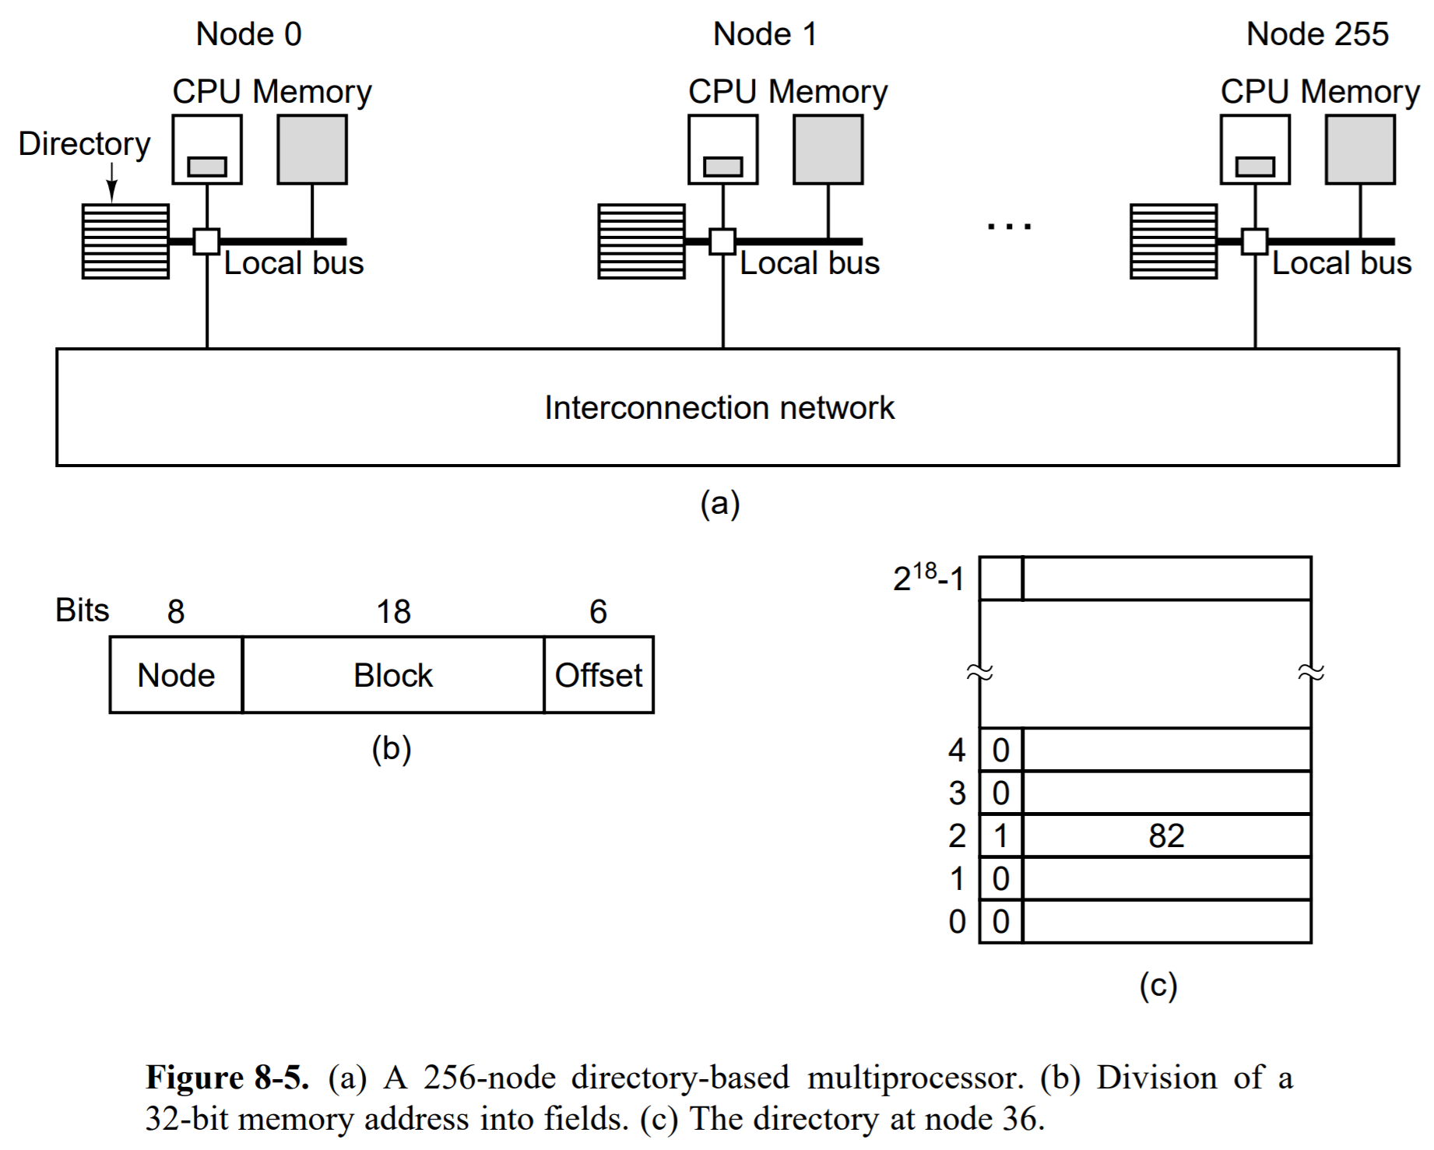
NUMA
Directory Based Multiprocessor
All NUMA systems have:
1. A single address space visible to all CPUs.
2. Access to remote memory is via LOAD and STORE instructions.
3. Access to remote memory is slower than access to local memory.

Slide 24
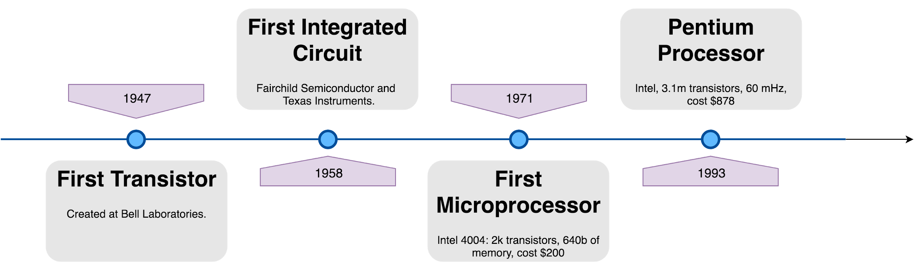
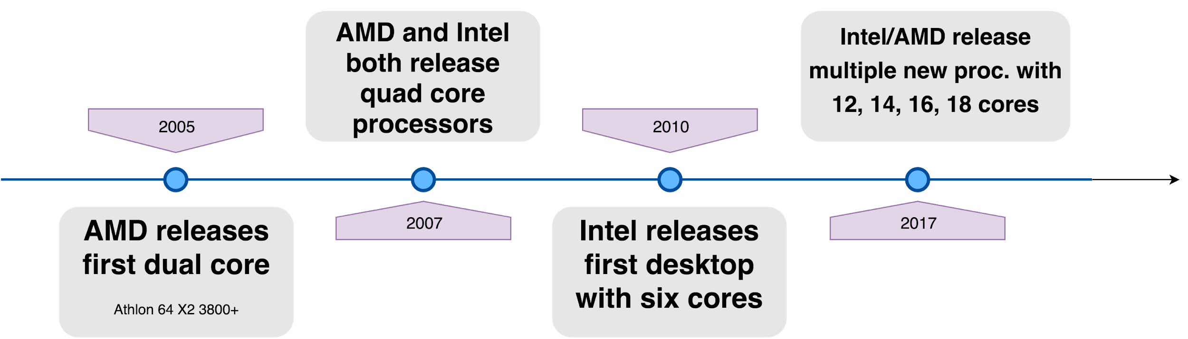
Timeline
Notes:
TALK ABOUT HISTORICAL SIGNIFICANCE

Slide 25

Multitasking
Formal definition: the concurrent performance or interleaved execution of two or more computer tasks; same as multiprogramming, using different terminology.
Informal explanation:

Slide 26
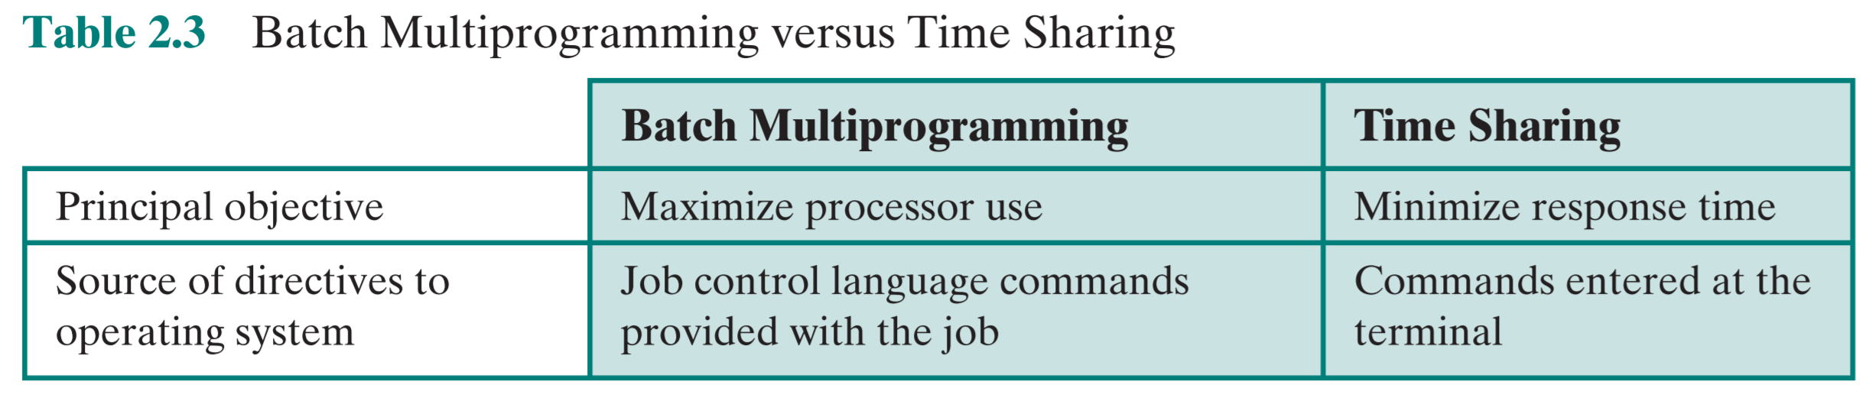
Multitasking
Multiprogramming ===> context switching
Multitasking ===> time sharing along with context switching
So for multitasking to take place there should be multiprogramming and the concept of time sharing.
Notes:
Both the terms share almost the same meaning and are the common terms used in modern operating systems, but with different objectives. The concept of multiprogramming is based solely on the ability of the computer to store programs or instructions for a longer period of time in order to reduce the CPU idle time. The process allocation is done via scheduling algorithm. The OS executes part of one program at a time, followed by a part of another program and so on. In a multitasking OS, the CPU allows multiple processes to run simultaneously via time sharing and executes them accordingly.
Read more: Difference Between Multiprogramming and Multitasking in Operating System | Difference Between | Multiprogramming vs Multitasking in Operating System http://www.differencebetween.net/technology/difference-between-multiprogramming-and-multitasking-in-operating-system/#ixzz5gYNGd7xl

Slide 27
Multiprogramming v. Multitasking
Multiprogramming:
-Multiple processes run concurrently on a single processor
-Based on context switching
-Takes more time to execute processes
Multitasking:
-More than one task is executed at a single time on multiple CPUs
-Based on time sharing
-Takes less time to execute tasks/processes

Slide 28
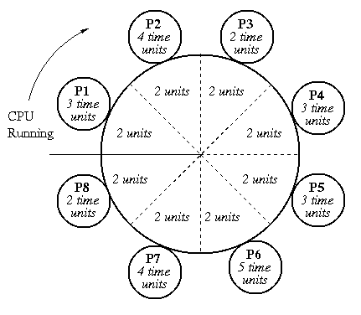
Time Sharing
-When there are multiple users accessing a machine at once, the OS must keep track of what each user is doing simultaneously
-Controlled by time-slicing (preemption of users at certain intervals)
Notes:
Multiple users simultaneously accessing system through terminals, with the OS interleaving the execution of each user program in a short burst of computation.

Slide 29

Historical Significance
Notes:
-Earlier machines were so slow that processes would need to complete before another process could be handled

Slide 30
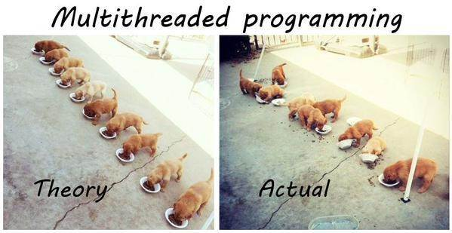

Slide 31
Multithreading
Formal definition:
A thread is an independent stream of instructions that can be scheduled as such by the operating system.
Informal explanation:
Multithreading is the use of multiple threads (in parallel) on shared memory multiprocessor architectures. As threads are lightweight, they can be viewed as “children” of processes as they use process resources after they have been unleashed in execution.

Slide 32
How Threads Work
-Threads make use of the parent process stack pointer, registers, scheduling properties, and data
-Have different models to choose from: manager/worker, pipeline, and peer
-A thread dies if the parent process dies/ has completed its execution
-Threads can be written to deal with asynchronous programs

Slide 33
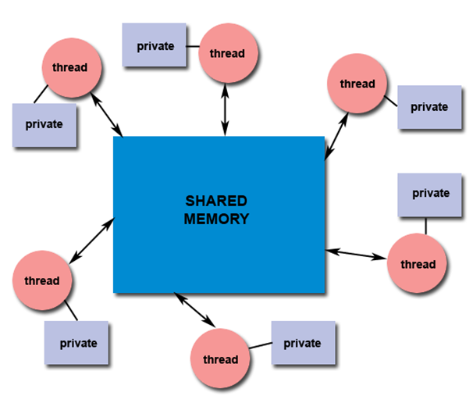
How Threads Work

Slide 34
Multithreading Advantages
-Concurrency is a result of programming a multithreaded program. Ultimately it decreases the execution time of a program due to its mimicking of multiple programs running at once.
-Single-Core systems have an advantage of using threads to handle all the input and output where they otherwise may not be able to do any parallelism.
-Shared resources means less memory being used to accomplish tasks.
-Multi threading is cost efficient physically also, as it allows for many tasks to be completed with fewer processors.
Notes:
Benefits of Multi threading include increased responsiveness. Since there are multiple threads in a program, so if one thread is taking too long to execute or if it gets blocked, the rest of the threads keep executing without any problem. Thus the whole program remains responsive to the user by means of remaining threads.
Creating brand new processes and allocating resources is a time consuming task, but since threads share resources of the parent process, creating threads and switching between them is comparatively easy. Hence multi threading is the need of modern Operating Systems.

Slide 35
POSIX Threads
-Also known as Pthreads.
-A standard for Unix-like operating systems.
-A library that can be linked with C programs.
-Specifies an application programming interface (API) for multi-threaded programming.

Slide 36
History & Timeline
- Processes in the Berkeley Timesharing System (1965)
-Eventually known as “tasks” in OS/360 Operating system by IBM (1966)
-Unix system shares resources among processes using signals (1970s)
-Modern threads came into being during the late 1970s/early 80s

Slide 37
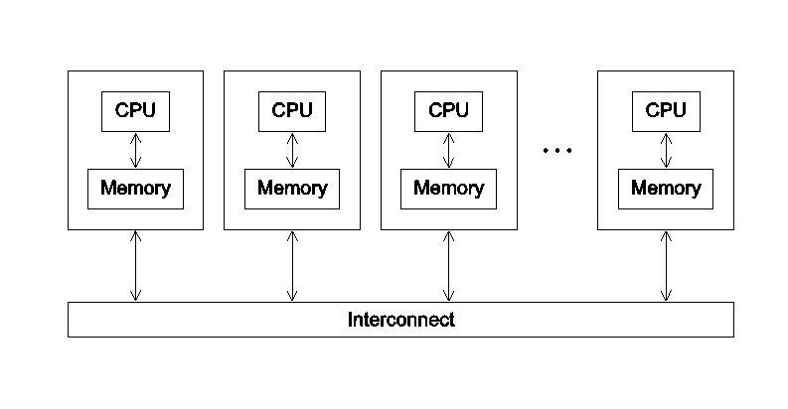
“Large-Scale” Threading
-Form of Massively Parallel Processing
-Acts like threading but on a larger scale
-Distributed Memory System
-Loosely coupled
Notes:
Program cooperates with other programs to solve a problem

Slide 38
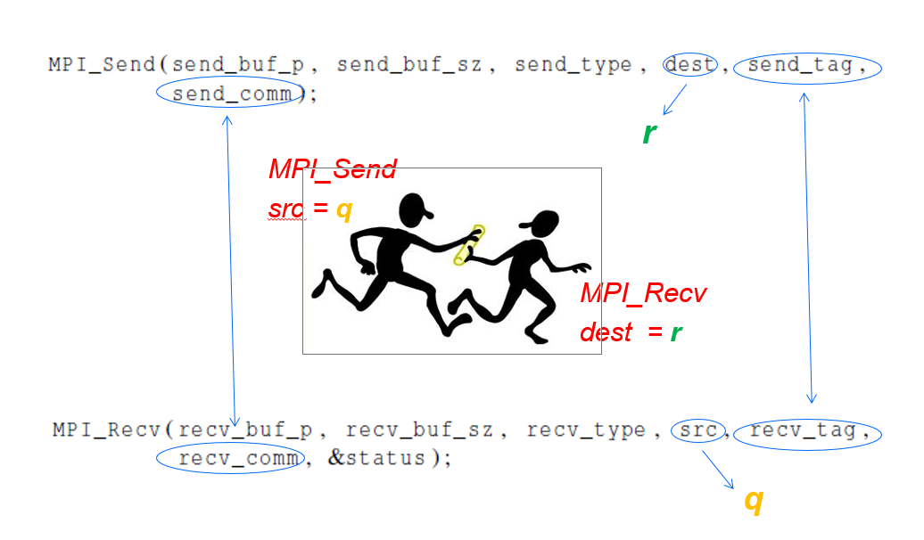
MPI: Message Passing Interface

Slide 39
Code Examples
MPI:
-Uses Script
Pthreads:
-”gcc −g −Wall −o pth_hello pth_hello.c −lpthread”
-”gcc FileName.c -o ExecutableName -lpthread”

Slide 40
Context Switching
In multiprogramming the “context” refers to that of a whole process whereas in multithreading the “context” may be that of a lighter thread.
Process context switching involves switching the virtual memory address space: this includes memory addresses, mappings, page tables, and kernel resources.
Thread context switching is context switching from one thread to another in the same process (i.e. there is no need to switch the virtual memory address space). This requires switching processor state (such as the program counter and register contents), which is generally very efficient.
Notes:
Switching from thread to thread across different processes is just like process context switching.

Slide 41
References
[1] Merriam-Webster https://www.merriam-webster.com/dictionary/multiprogramming [2] Operating System | Difference between multitasking, multithreading and multiprocessing, GeeksForGeeks https://www.geeksforgeeks.org/operating-system-difference-multitasking-multithreading-multiprocessing/
[3] Operating system/Multiprogramming https://en.m.wikiversity.org/wiki/Operating_system/Multiprogramming
[4] LEO computer https://en.wikipedia.org/wiki/LEO_(computer)#Applications_and_successors
[5] THE Multiprogramming System https://en.m.wikipedia.org/wiki/THE_multiprogramming_system
MULTIPLE PROCESSOR SYSTEMS https://www.cs.vu.nl/~ast/books/mos2/sample-8.pdf
Computer processor history https://www.computerhope.com/history/processor.htm
A Brief History of Multiprocessors and EDA https://ieeexplore.ieee.org/document/5766819
The History of Threads http://www.serpentine.com/blog/threads-faq/the-history-of-threads/

